Slide 1
Decision Tree

Slide 2
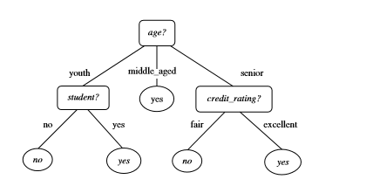
A decision tree for the concept buys computer, indicating whether an Electronics Store customer is likely to
purchase a computer. Each internal (nonleaf) node represents a test on an attribute. Each leaf node represents
a class (either buys computer=yes or buys computer =no).

Slide 3
Why are decision tree classiﬁers so popular
The construction of decision tree classiﬁers does not require any domain knowledge or parameter setting, and therefore is appropriate for exploratory knowledge discovery.
Decision trees can handle Multidimensionaldata.
Their representation of acquired knowledge in tree form is intuitive and generally easy to assimilate by humans.
The learning and classiﬁcation steps of decision tree induction are simple and fast. In general, decision tree classiﬁers have good accuracy.
However, successful use may depend on the data at hand.
Decision tree induction algorithmshave beenusedfor classiﬁcation in many application areas such as medicine, manufacturing and production, ﬁnancial analysis, astronomy, and molecular biology. Decision trees are the basis of several commercial rule induction systems

Slide 4
Decision Tree Classification
Decision tree builds classification or regression models in the form of a tree structure.
It breaks down a dataset into smaller and smaller subsets while at the same time an associated decision tree is incrementally developed.
The final result is a tree with decision nodes and leaf nodes.
A decision node (e.g., Outlook) has two or more branches (e.g., Sunny, Overcast and Rainy). Leaf node (e.g., Play) represents a classification or decision.
The topmost decision node in a tree which corresponds to the best predictor called root node.
Decision trees can handle both categorical and numerical data.

Slide 5
Main ideas behind the ID3 algorithm are:
Each non-leaf node of a decision tree corresponds to an input attribute, and each arc to a possible value of that attribute.
A leaf node corresponds to the expected value of the output attribute when the input attributes are described by the path from the root node to that leaf node.
In a “good” decision tree, each non-leaf node should correspond to the input attribute which is the most informative about the output attribute amongst all the input attributes not yet considered in the path from the root node to that node because we would like to predict the output attribute using the smallest possible number of questions on average.
Entropy is used to determine how informative a particular input attribute is about the output attribute for a subset of the training data.

Slide 6
Information Gain
ID3 (Iterative Dichotomiser) uses information gain as its attribute selection measure
Let node N represent or hold the tuples of partition D
The attribute with the highest information gain is chosen as the splitting attributefor node N.
This attribute minimizes the information needed to classify the tuples in the resulting partitions and reﬂects the least randomness or “impurity” in these partitions.
Such an approach minimizes the expected number of tests needed to classify a given tuple and guarantees that a simple (but not necessarily the simplest) tree is found.

Slide 7
DAY | OUTLOOK | TEMPERATURE | HUMIDITY | WIND | PLAY TENNIS
1 | SUNNY | HOT | HIGH | WEAK | NO
2 | SUNNY | HOT | HIGH | STRONG | NO
3 | OVERCAST | HOT | HIGH | WEAK | YES
4 | RAIN | MILD | HIGH | WEAK | YES
5 | RAIN | COOL | NORMAL | WEAK | YES
6 | RAIN | COOL | NORMAL | STRONG | NO
7 | OVERCAST | COOL | NORMAL | STRONG | YES
8 | SUNNY | MILD | HIGH | WEAK | NO
9 | SUNNY | COOL | NORMAL | WEAK | YES
10 | RAIN | MILD | NORMAL | WEAK | YES
11 | SUNNY | MILD | NORMAL | STRONG | YES
12 | OVERCAST | MILD | HIGH | STRONG | YES
13 | OVERCAST | HOT | NORMAL | WEAK | YES
14 | RAIN | MILD | HIGH | STRONG | NO

Slide 8
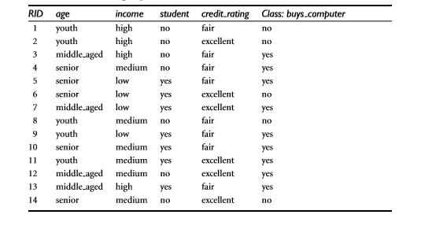
task

